Slide 1
Spline Interpolation: Linear Spline Interpolation (LSI)
Lecture-1

Slide 2
Objectives
Plotting line or curve using providing data sets
Analyze line or curve
Applications
Data analysis numerically in Mathematics
Spline Interpolation
In the mathematical field of numerical analysis, spline interpolation is a form of interpolation where the interpolant is a special type of piecewise polynomial called a spline. It is often preferred over polynomial interpolation because the interpolation error can be made small even when using low degree polynomials for the spline.

Slide 3
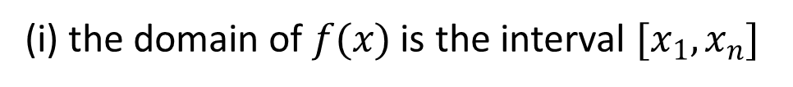
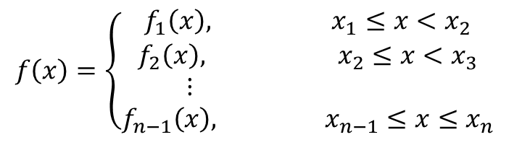
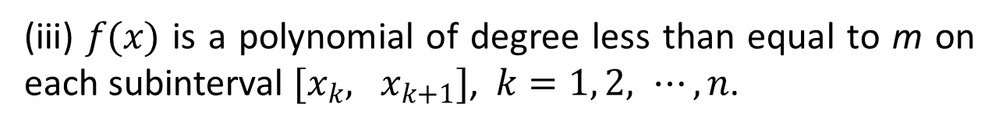
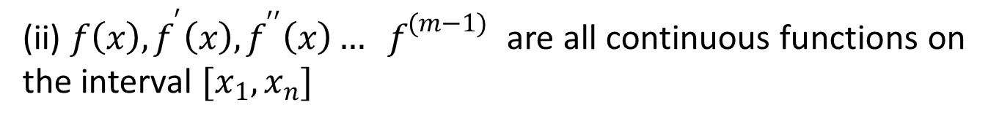
Definition of Spline Interpolation
Spline interpolation function is a piecewise polynomial function joined together with certain conditions satisfied by them. A function f(x) of the form
$$f\left(x\right)=\left\{\begin{aligned}f_{1}\left(x\right), x_{1}≤x<x_{2} \\ f_{2}\left(x\right), x_{2}≤x<x_{3} \\ ⋮ \\ f_{n−1}\left(x\right), x_{n−1}≤x≤x_{n}\end{aligned}\right.$$
is called a spline of degree m if
(i) the domain of $f(x)$ is the interval $[x_{1}, x_{n}]$
(ii) ${f\left(x\right), f}^{′}\left(x\right), f^{′′}\left(x\right)… f^{(m−1)}$ are all continuous functions on the interval $[x_{1}, x_{n}]$
(iii) $f(x)$ is a polynomial of degree less than equal to m on each subinterval $[x_{k}, x_{k+1}]$, $k=1, 2, ⋯, n$.

Slide 4
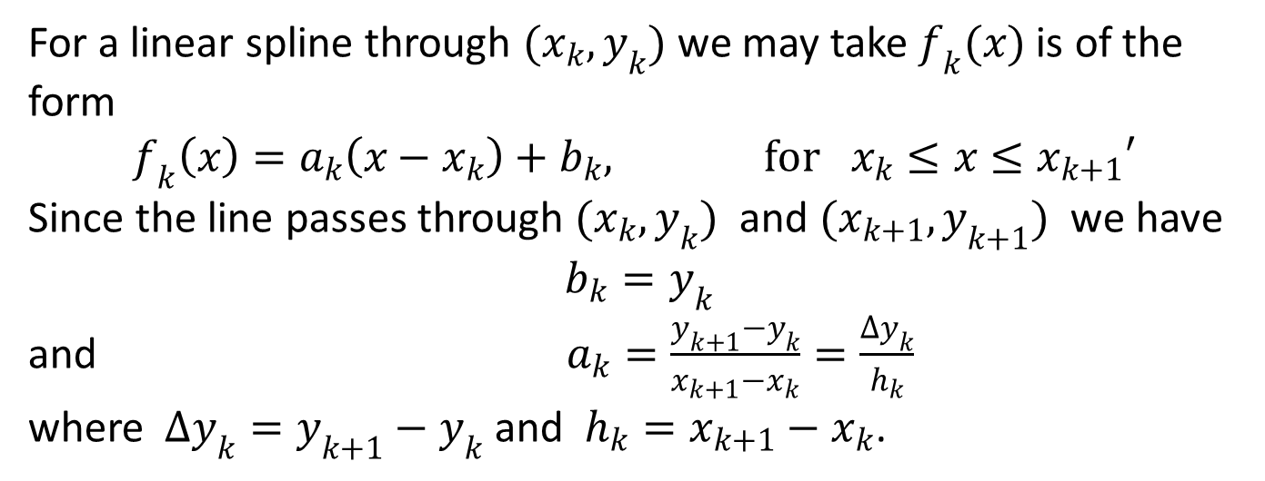
Spline Interpolation
Linear Spline Interpolation (LSI)
Cubic Spline Interpolation(CSI)
Linear Spline Interpolation (LSI)
For a linear spline through $(x_{k}, y_{k})$ we may take $f_{k}(x)$ is of the form
$$f_{k}\left(x\right)=a_{k}\left(x−x_{k}\right)+b_{k}, for x_{k}≤x≤x_{k+1}′$$
Since the line passes through $(x_{k}, y_{k})$ and $(x_{k+1}, y_{k+1})$ we have
$$b_{k}=y_{k}$$
and $a_{k}=\frac{y_{k+1}−y_{k}}{x_{k+1}−x_{k}}=\frac{∆y_{k}}{h_{k}}$
where $∆y_{k}=y_{k+1}−y_{k}$ and $h_{k}=x_{k+1}−x_{k}$.

Slide 5
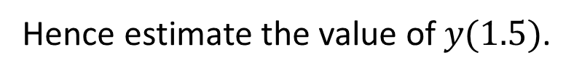
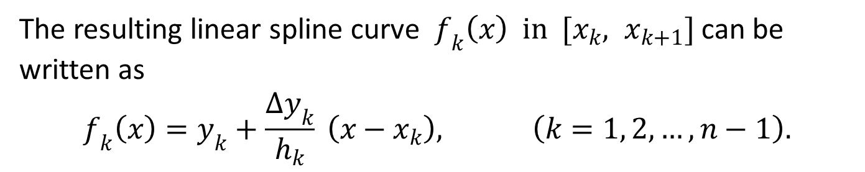
The resulting linear spline curve $f_{k}\left(x\right) in [x_{k}, x_{k+1}]$can be written as
$$f_{k}\left(x\right)=y_{k}+\frac{∆y_{k}}{h_{k}} \left(x−x_{k}\right), \left(k=1, 2, …,n−1\right).$$
Example
Find the linear spline for the following data set
X | −1 | 1 | 2 | 5
Y | 2.2 | 3.5 | 5.4 | 1.5
Hence estimate the value of $y(1.5)$.

Slide 6
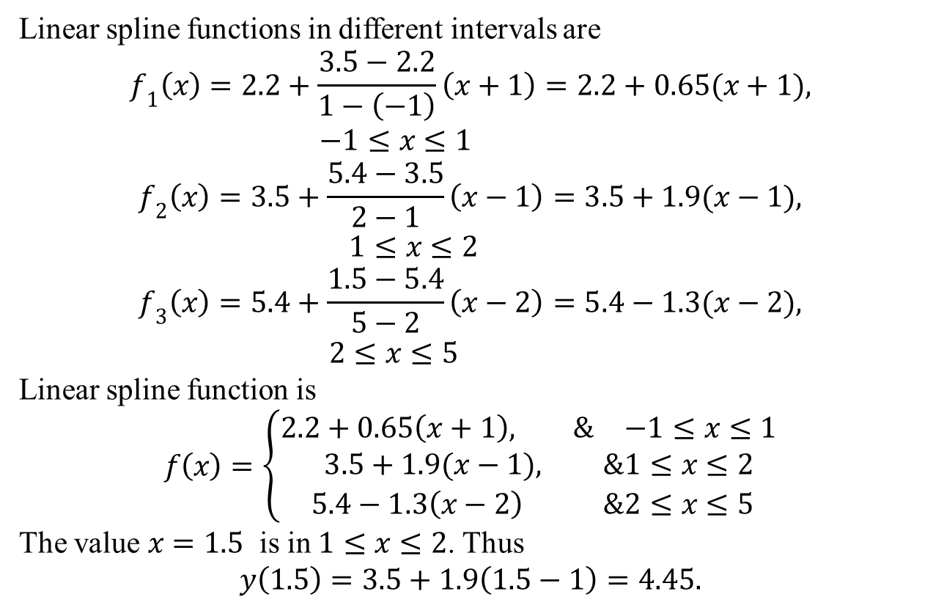
Solution:
Linear spline functions in different intervals are
$$f_{1}\left(x\right)=2.2+\frac{3.5−2.2}{1−\left(−1\right)}\left(x+1\right)=2.2+0.65(x+1), −1≤x≤1$$
$$f_{2}\left(x\right)=3.5+\frac{5.4−3.5}{2−1}\left(x−1\right)=3.5+1.9(x−1), 1≤x≤2$$
$$f_{3}\left(x\right)=5.4+\frac{1.5−5.4}{5−2}\left(x−2\right)=5.4−1.3(x−2), 2≤x≤5$$
Linear spline function is
$$f\left(x\right)=\left\{\begin{aligned}2.2+0.65\left(x+1\right), &−1≤x≤1 \\ 3.5+1.9(x−1), &1≤x≤2 \\ 5.4−1.3\left(x−2\right) &2≤x≤5\end{aligned}\right.$$
The value $x=1.5$ is in $1≤x≤2$. Thus
$$y\left(1.5\right)=3.5+1.9\left(1.5−1\right)=4.45.$$

Slide 7
Outcomes
Numerically get value of a function at specific value belongs to the given data sets by using LSI.
Try to do yourself
Exercise 1: In a chemical reaction the concentration level y of the
product at time t (minute) was measured every half hour. The following results were found:
t | 1.0 | 1.5 | 2.0 | 2.5
y | 0.25 | 0.27 | 0.31 | 0.46
Construct a linear spline interpolation to estimate the concentration level at 2.2 minute.

Slide 8
Exercise 2: Use the portion of the given steam table for superheated
H₂O at 200 MPa to find the corresponding entropy, s, for a specific volume, v, of 0.118 m³/kg with linear spline.
V (m³/kg) | 0.2037 | 0.2114 | 0.32547 | 0.33213
S (kJ/kg K) | 6.5147 | 6.6453 | 6.8664 | 6.9513
Cubic Spline Interpolation(CSI)
Cubic spline interpolation is used very often. It gives smoother curves than other types. To determine the cubic spline, we need to use cubic polynomial for each subintervals.

Slide 9
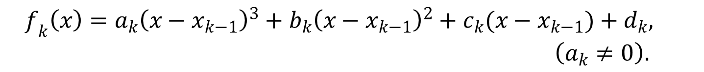

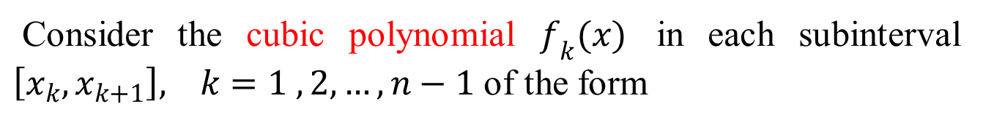
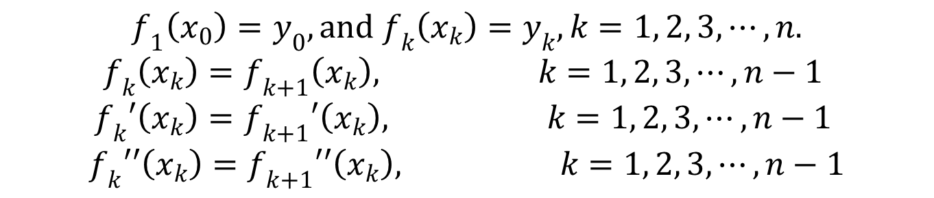

Consider the cubic polynomial $f_{k}(x)$ in each subinterval $\left[x_{k}, x_{k+1}\right], k=1 ,2, …, n−1$ of the form
$$f_{k}\left(x\right)=a_{k}{\left(x−x_{k−1}\right)}^{3}+b_{k}{\left(x−x_{k−1}\right)}^{2}+c_{k}(x−x_{k−1})+d_{k}, \left(a_{k}≠0\right).$$
where $a_{k}, b_{k}, c_{k} and{ d}_{k}$ are to be determined.
Since the spline passes through $\left(x_{k}, y_{k}\right),$ and $f_{k}(x)$,
$$f_{1}\left(x_{0}\right)=y_{0}, and f_{k}\left(x_{k}\right)=y_{k}, k=1, 2, 3, ⋯, n.$$
$$f_{k}\left(x_{k}\right)=f_{k+1}\left(x_{k}\right), k=1, 2, 3, ⋯, n−1$$
$$f_{k}′\left(x_{k}\right)=f_{k+1}′\left(x_{k}\right), k=1, 2, 3, ⋯, n−1$$
$$f_{k}′′\left(x_{k}\right)=f_{k+1}′′\left(x_{k}\right), k=1, 2, 3, ⋯, n−1$$
We can see that there are
$$1+n+3\left(n−1\right)=4n−2$$
conditions but we need to determine 4n constants.

Slide 10
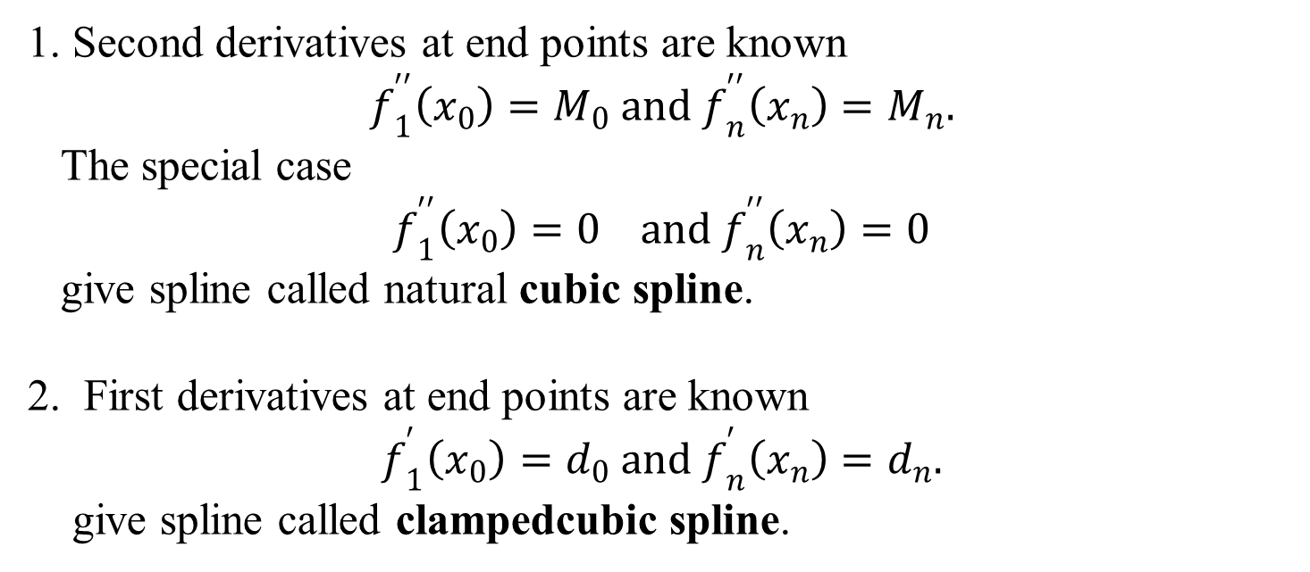
Boundary conditions
So we need to add two boundary conditions to get unique solution. Normally we use three types of boundary conditions:
1. Second derivatives at end points are known
$$f_{1}^{′′}\left(x_{0}\right)=M_{0} and f_{n}^{′′}\left(x_{n}\right)=M_{n}.$$
The special case
$$f_{1}^{′′}\left(x_{0}\right)=0 and{ f}_{n}^{′′}\left(x_{n}\right)=0$$
give spline called natural cubic spline.
2. First derivatives at end points are known
$$f_{1}^{′}\left(x_{0}\right)=d_{0} and{ f}_{n}^{′}\left(x_{n}\right)=d_{n}.$$
give spline called clampedcubic spline.

Slide 11
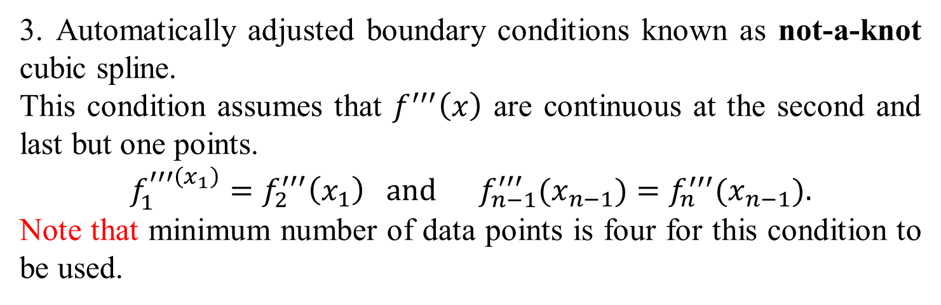
3. Automatically adjusted boundary conditions known as not-a-knot cubic spline.
This condition assumes that $f^{′′′}\left(x\right)$ are continuous at the second and last but one points.
$$f_{1}^{′′′\left(x_{1}\right)}=f_{2}^{′′′}\left(x_{1}\right) and f_{n−1}^{′′′}(x_{n−1})=f_{n}^{′′′}(x_{n−1}).$$
Note that minimum number of data points is four for this condition to be used.

Slide 12
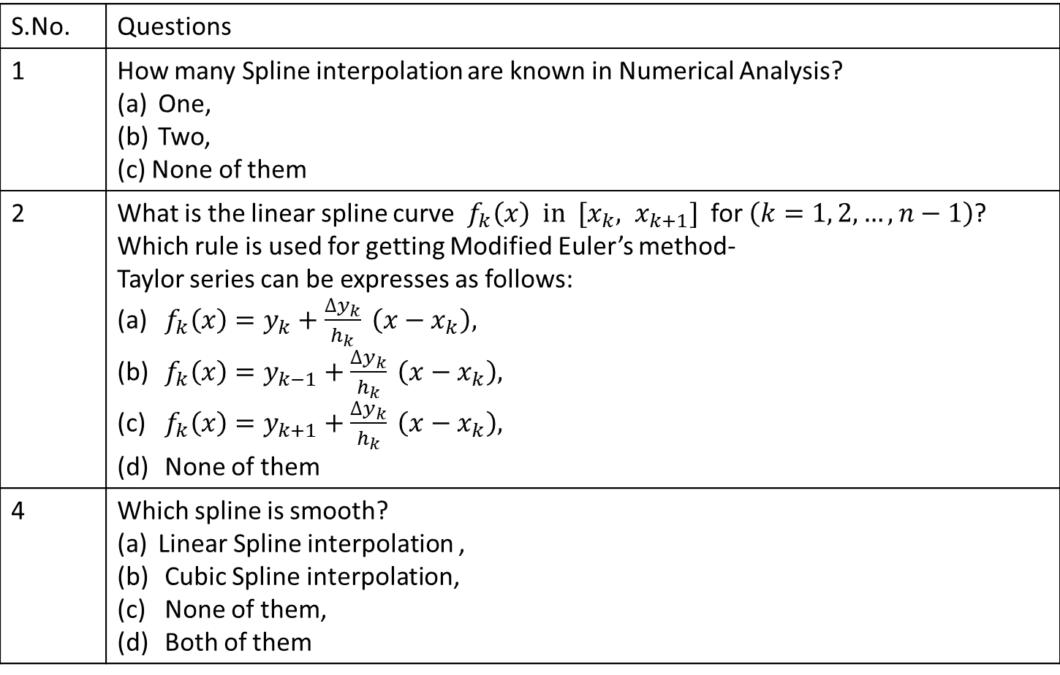
Multiple questions:
S.No. | Questions
1 | How many Spline interpolation are known in Numerical Analysis? One, Two, (c) None of them
2 | What is the linear spline curve $f_{k}\left(x\right) in [x_{k}, x_{k+1}]$ for $\left(k=1, 2, …,n−1\right)$? Which rule is used for getting Modified Euler’s method- Taylor series can be expresses as follows: $f_{k}\left(x\right)=y_{k}+\frac{∆y_{k}}{h_{k}} \left(x−x_{k}\right),$ $f_{k}\left(x\right)=y_{k−1}+\frac{∆y_{k}}{h_{k}} \left(x−x_{k}\right),$ $f_{k}\left(x\right)=y_{k+1}+\frac{∆y_{k}}{h_{k}} \left(x−x_{k}\right),$ None of them
4 | Which spline is smooth? Linear Spline interpolation , Cubic Spline interpolation, None of them, Both of them

Slide 13
References
[1] Applied Numerical Methods With Matlab for Engineers and Scientists ( Steven C.Chapra).
[2] Applied Numerical Analysis – C.F.Gerald & P.O.Wheatley, 7th Edition, 2003, Pearson Education Limited, USA.
[3] Numerical Analysis & Computing – W. Cheney & D. Kincaid, 6th Edition, 2007, Cengage Learning, Inc, USA.
[4] Numerical Analysis – J. Douglas Faires , Annette Burden , Richard Burden, 10th Edition, 2015, Cengage Learning, Inc, USA.

